Slide 1


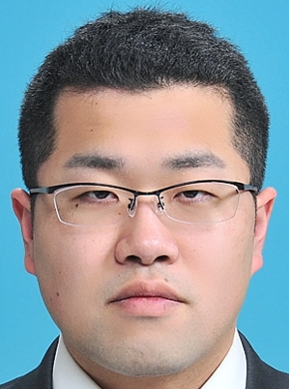
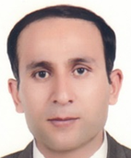






Muhammad HUDA（EC；PLN） “Techno-Economic Analysis of Vehicle-to-Grid (V2G) Integration as Distributed Energy Resources in Indonesia Power System”
’19 autumn
Yutaro Shimada（GEDES；Ph.D） “Study on Optimum Operation Condition of Ground Source Heat Pump in Bangkok, Thailand based on the Field Experiment.”
Elec.Eng.
Mech.
Moe Chen（EC； Toyota China R&D Center; China）
“Techno-economic analysis on hydrogen energy views from macroscope and microscope”
’19 spring
Kengo Takeda（EC；MHIEC）
“Risk analysis for importing natural gas to Japan regarding to energy security”
Mech.
E.E.
Dr.
Nadimi Reza（GEDES； Challenergy）
“Relationship between quality of life (QoL) and energy in supply/demand: Employing sigmoid to address human development”
‘18autumn
Anggoro Fitrianto（GEDES; Geospatial Information Agency,; Indonesia) “Study on estimating the amount of empty fruit bunch using remote sensing technique”
Appl.Stat.
GIS
Shiori Tanaka（GEDES; Accenture） “A field survey of relationship between subjective well-being and social capital in 4 European countries and 3 Asian countries”
’18 spring
Hiroto Takaki（EC；Pacific consultants） “Study on a model to Cost of Electricity for biomass including learning effect to evaluate Feed-in-Tarif price”
Appl.Chem.
Physics.
’17 spring
Old department
Masato Suzuki（Tokyo Metropolitan Govenment）：”Quantitative analysis between economic circulation and environmental burden in Japanese local area”
Arif Darmawan（Ph.D; Indonesia）：” Analysis of Coal-Cofiring with Hydrothermally-Treated Empty Fruit Bunch and Black Liquor gasification: System Assessment of coal-fired power plants”
Env.Econ.
Appl.Phys.
Moritaka Maeda（JXTG）： “Development of global crop supply and demand balance model considering relationship of food market and bioethanol”
’16 spring
Shuku Etsu（Seison automobile insurance；China）： “Research on Diffusion of NGV in Japan and Other Nations by Bass Model”
Appl. Stat.
Ind.Eng.

Slide 2

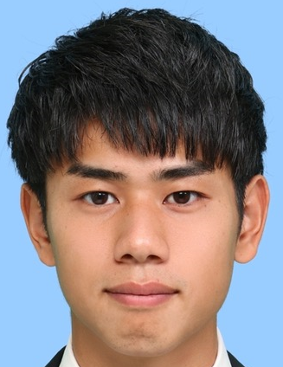
’20 spring
Arif Darmawan（back to BPPT; Indonesia）：” Energy-efficient conversion from industrial waste biomass by combining exergy recovery and process integration”
Dr.
Alrashoud Khalid（Embassy of the Kingdom of Saudi Arabia in Japan; Saudi Arabia）：” Managing Technology Transition: An Analysis of Residential Solar Photovoltaic Systems Development in Saudi Arabia”
Dr.
Norfadhilah Binti Hamzah（back to xxx; Malaysia）：” Techno-Economic Assessment of Hydrothermal Treatment from Municipal Solid Waste and Oil Palm Biomass as Coal Substitute in Malaysia”
Dr.
Michino Hashizume（Sumitomo Heavy Industry）：” Environmental Impact Assessment on Wastes from Forest-related industries to Electricity in Southeast Asia” (東南アジアにおける森林関連産業廃棄物の発電利用に関する環境影響評価)
B
Purevsuren Norovsambuu（Ms.course; Mongolia）：” The Import Structure of LNG from Russia to Japan by Cognitive Map and Text Analysis”
B
Daigou Furuichi（Ms.course in U.Tokyo）：” Energy poverty in Japan focusing on vulnerable households”（脆弱な世帯に着目した，日本におけるエネルギー貧困）

